Slide 1
NLP: Lyrics Generation
MD MURAD ALAM alam.1650102@studenti.uniroma1.it
SIMONE GIGANTE I simone.gigante01@estudiant.upf.edu
ADRIEN ROUGERON rougeron.1935969@studenti.uniroma1.it

Slide 2
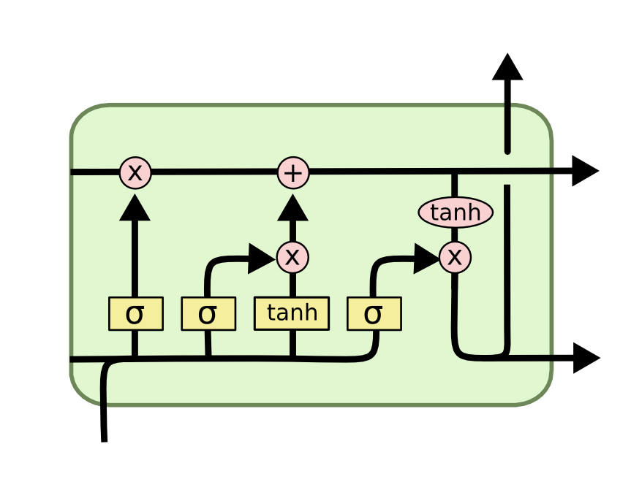
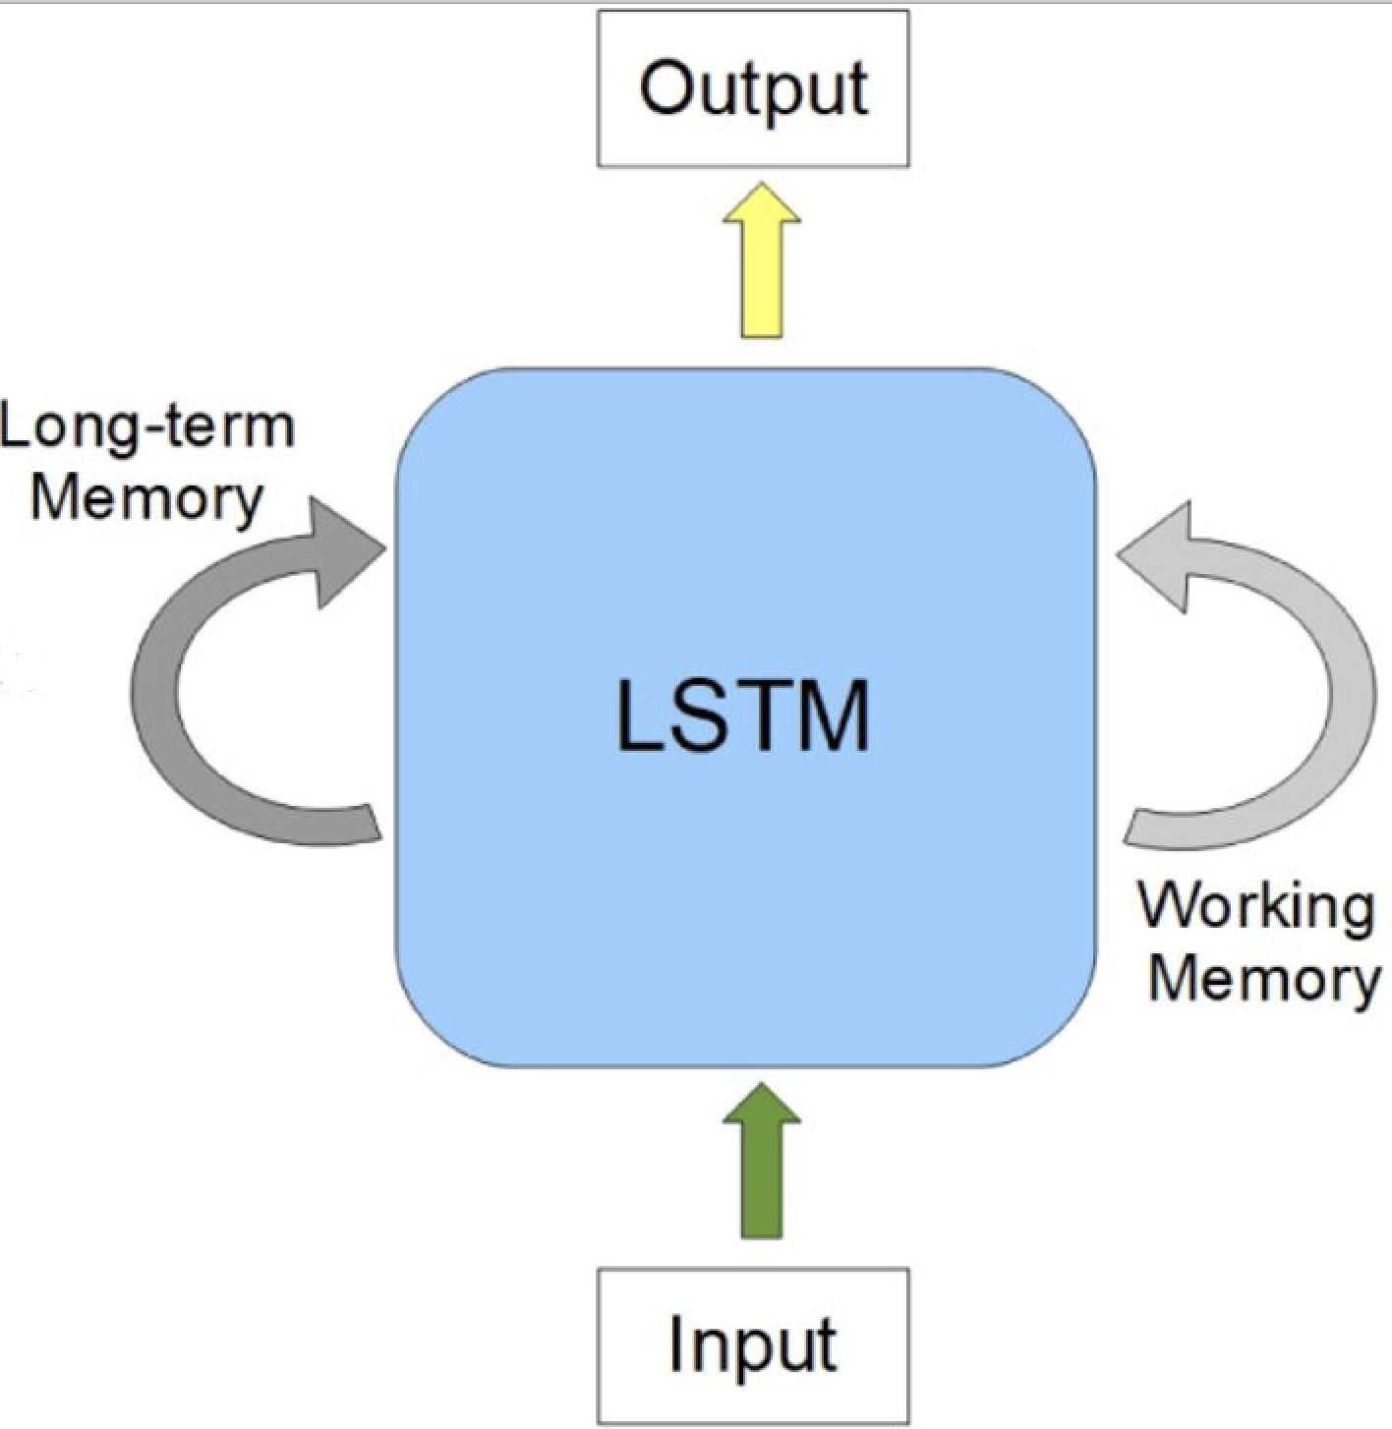
LSTM
LSTM stands for “Long Short Term Memory networks”.
LSTM is a kind of RNN.
LSTM is capable of learning long term dependencies.
4. LSTM contains four interacting layers.

Slide 3
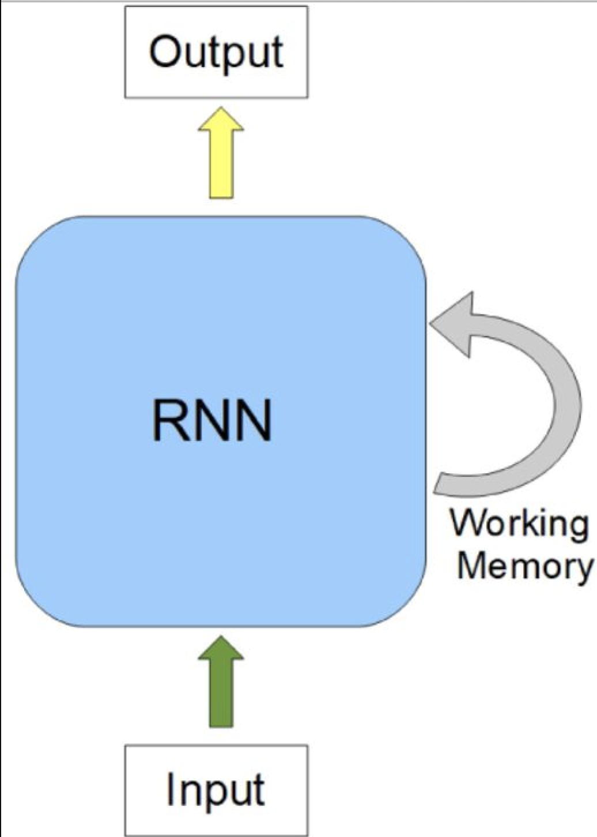
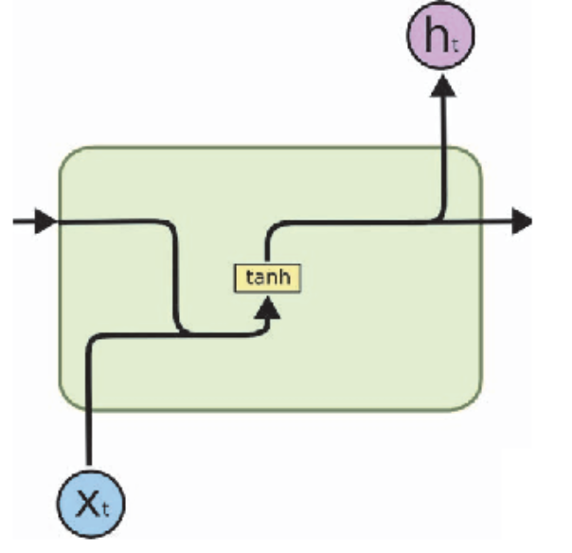
RNN
RNN stands for Recurrent Neural Network.
2. RNN contains a single layer

Slide 4
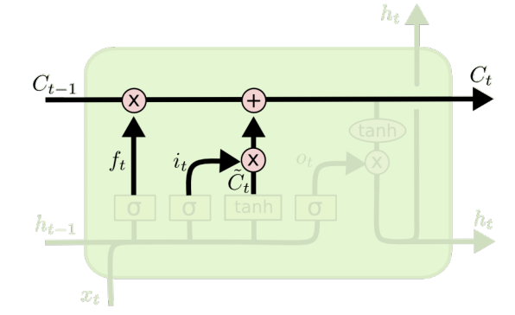
LSTM Cell
The horizontal line running through the top of the diagram.
It is a kind of like a conveyor belt.
3. LSTM can remove or add information to the cell state

Slide 5
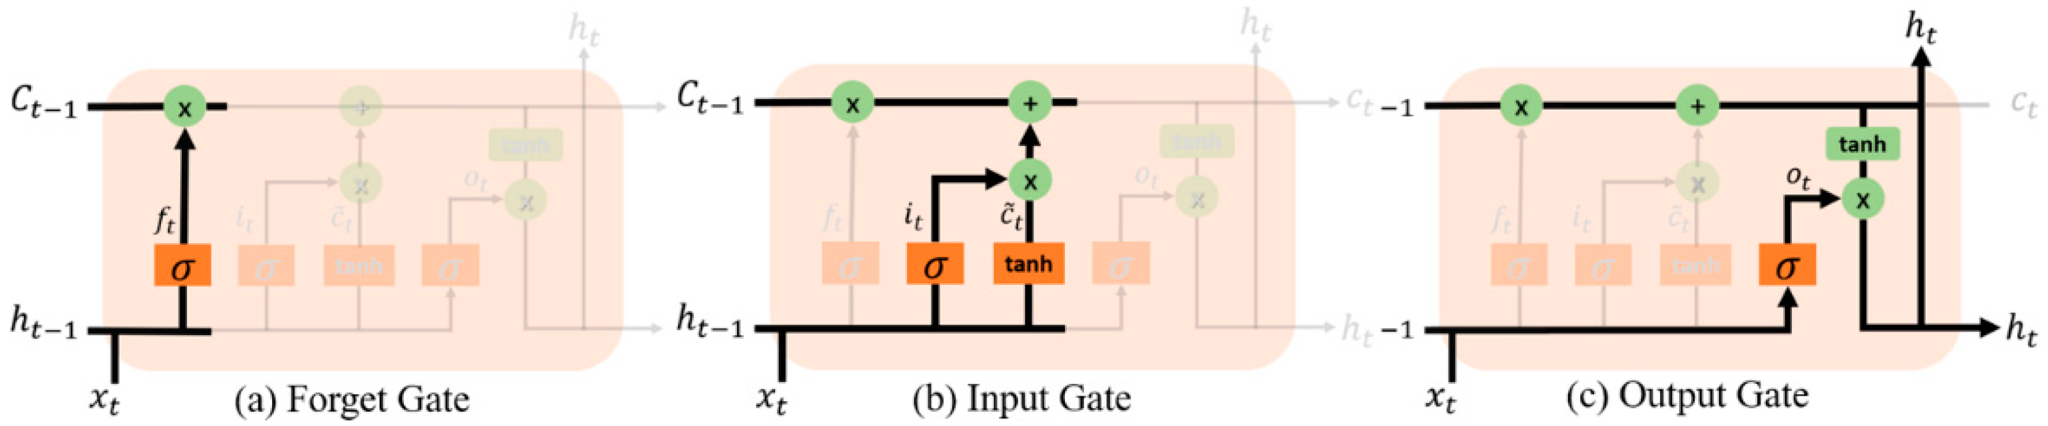
LSTM Gates
Forget Gate:- The first step is the forget gate, in which the sigmoid function outputs a value ranging from 0 to 1 to determine how much information of the previous hidden state and current input it should retain.
2. Input Gate:-First, the input gate determines what new information to store in the memory cell. Next, a tanh layer creates a vector of new candidate values to be added to the state
3. Output Gate:-To determine what to output from the memory cell, we again apply the sigmoid function to the previous hidden state and current input, then multiply that with tanh applied to the new memory cell (this will make the values between -1 and 1).

Slide 6
Task
To generate lyrics through NLP, we complete the following tasks.
1. Prepare the Dataset
2. Create the LSTM Model
3. Train the the model
4. Predict from the model

Slide 7
Dataset
To create dataset, define a class and then inherit Dataset class from the PyTorch library from torch.utils.data import Dataset
Override the method __len__ and __getitem__
3. __len__ so that len(dataset) returns the size of the dataset.
4. __getitem__ to support the indexing such that dataset[i] can be used to get
ith sample
Manually define the method load_words() and get_unique_words()
6. load_words() method loads the all the lyrics words in an array of words
get_unique_words() method filtered and make a collection of the unique words from the collections of all words
8. idx_to_word and word_to_idx converts words to number indexes and visa
versa.

Slide 8
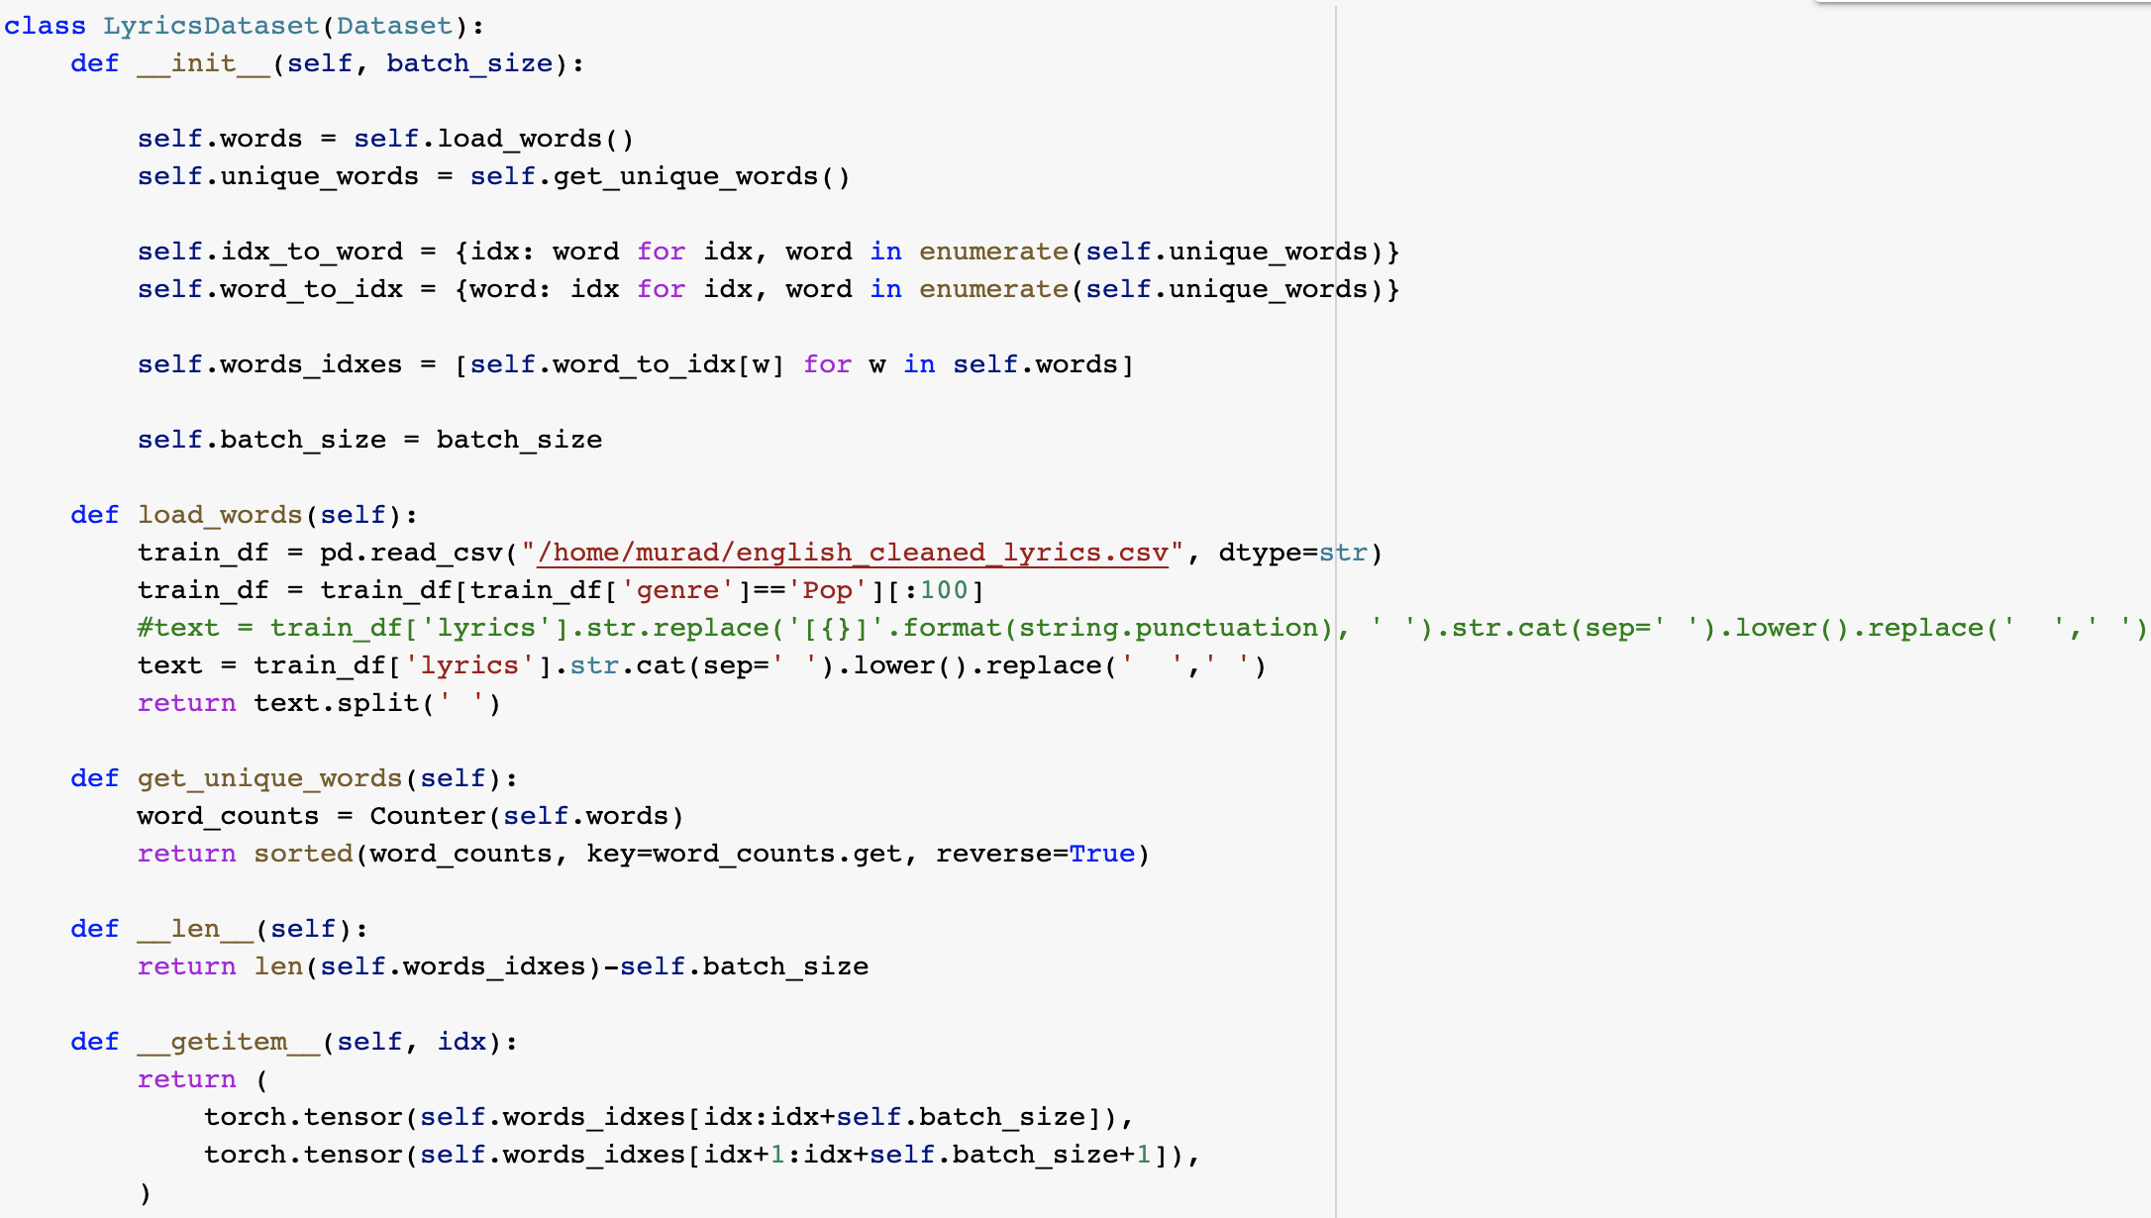
Dataset Continue..
LyricsDataset

Slide 9
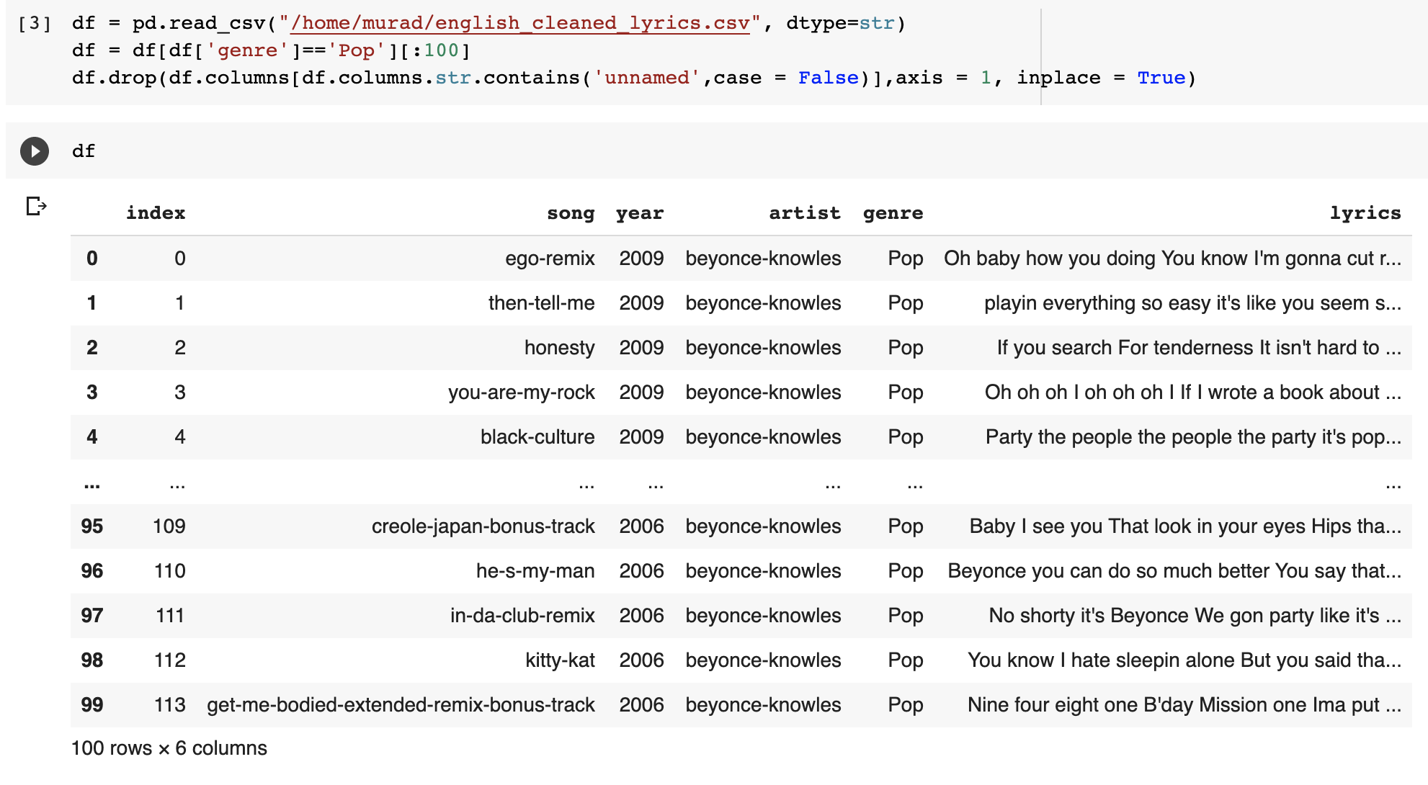
Dataset continue…
english_cleaned_lyrics.csv

Slide 10
LSTM Model
Create the LSTM Model in python with the help of PyTorch Library.
Embedding layer convert word indexes to word vectors.
LSTM cell that can learn long sequence of data.
prev_state is kept out_side the model and passed manually as an argument to the forward function
Init_state function is used to initialize the right shape of the state.

Slide 11
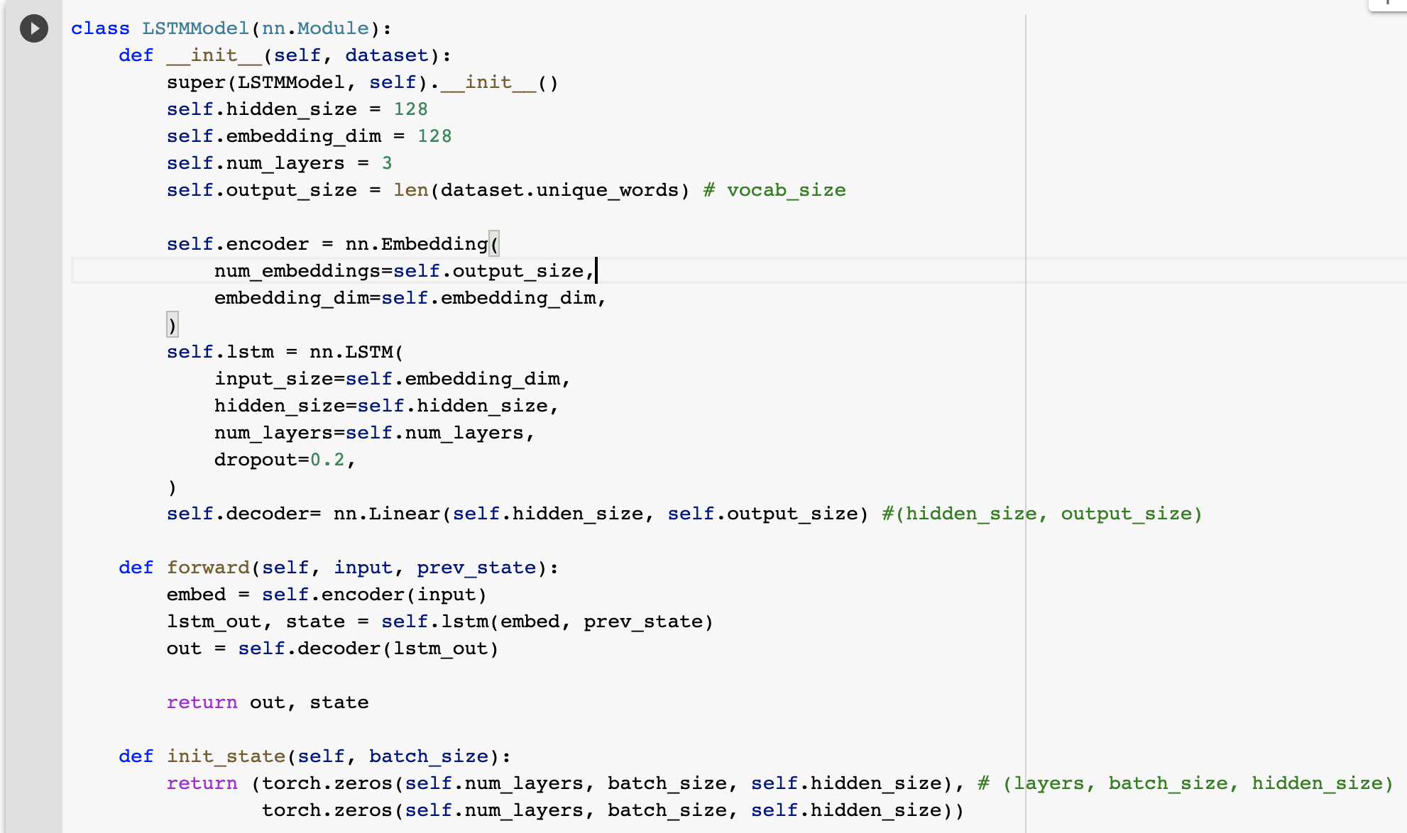
LSTM Model continue…
LSTMModel code

Slide 12
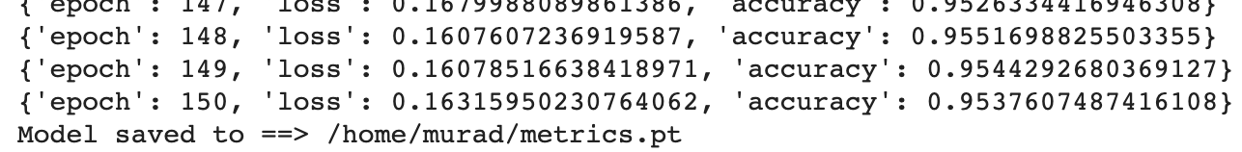
Train
1. No train No gain
2. Train the model to gain the accuracy before the prediction
3. Use Dataset and DataLoader abstraction to load the lyrics data.
4. Use CrossEntropyLoss and Adam as loss function and optimizer respectively.
5. After the 150 epochs , achieve an accuracy of 95.37% with a loss of 0.16

Slide 13
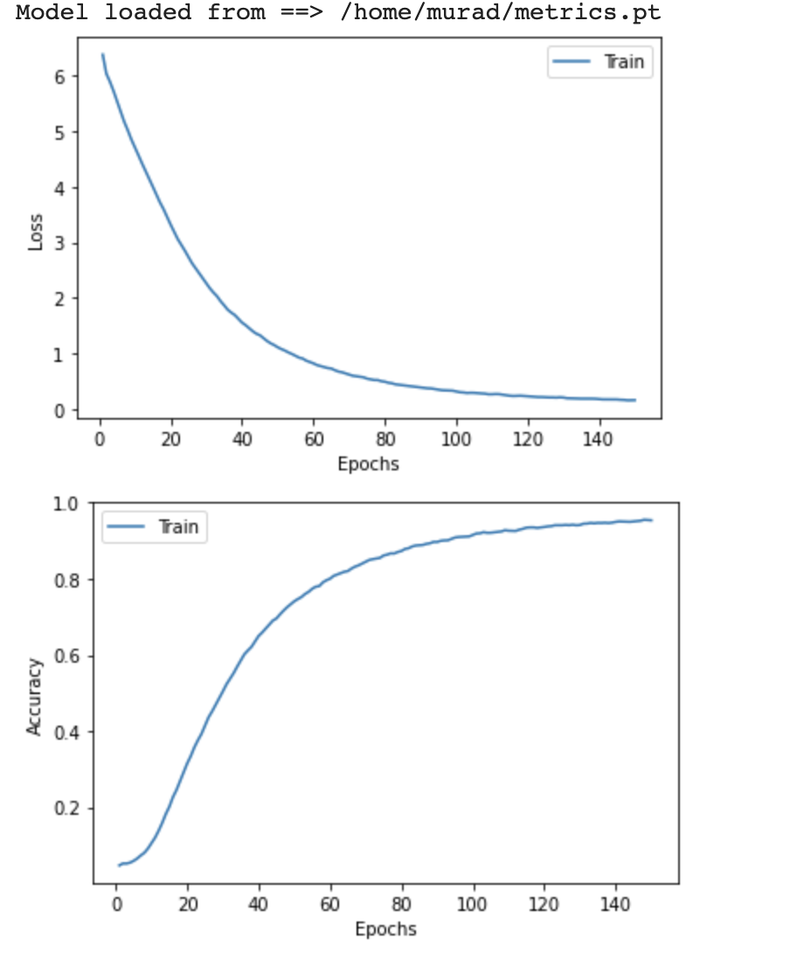
Train continue…
Loss & Accuracy Graph vs Epochs

Slide 14
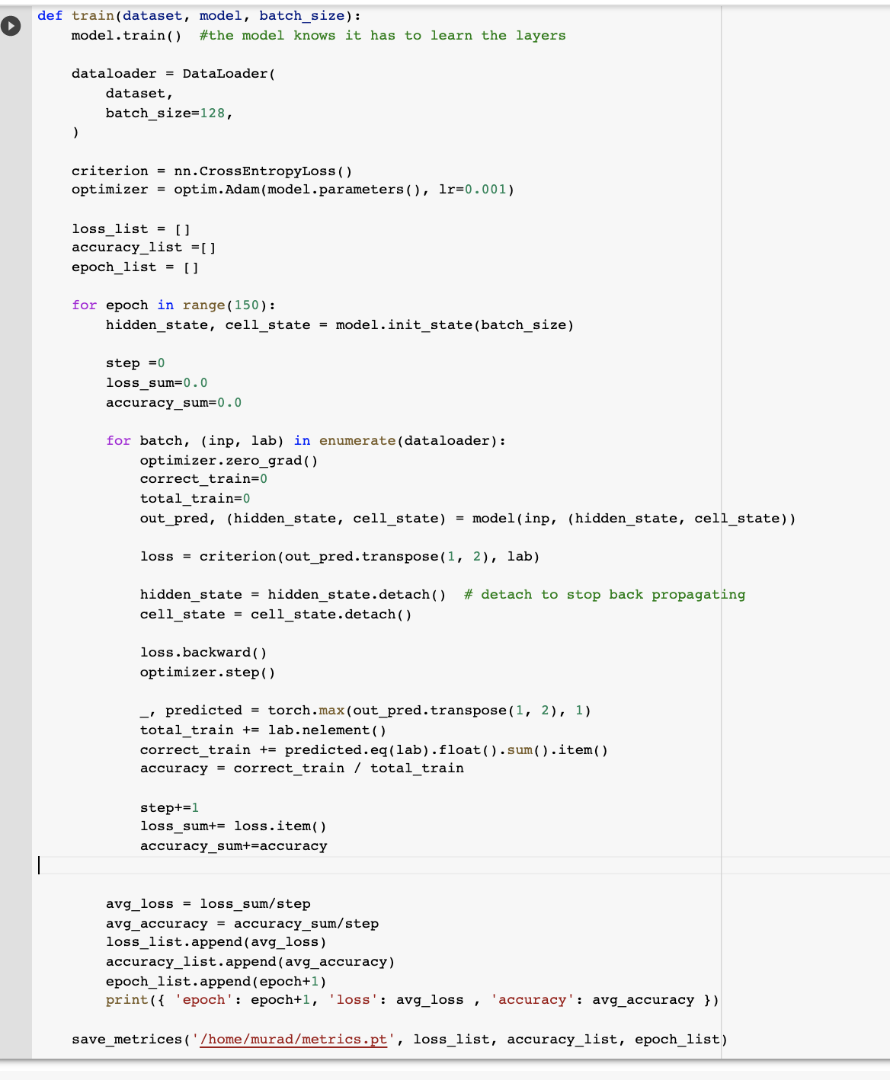
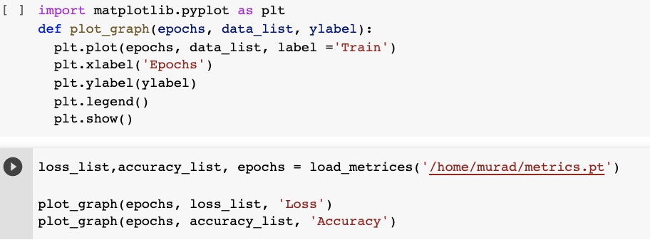
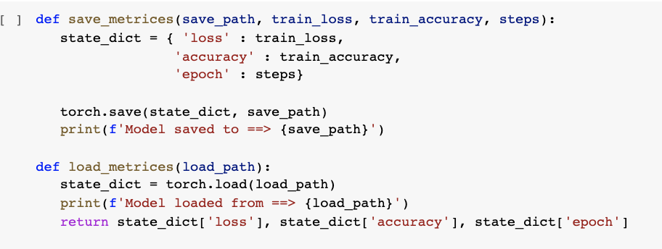
Train continue…
Train code

Slide 15
Prediction
To predict a lyric of 100 words . We pass a string of an arbitrary length as a seed to get the lyric.
Here, we passed a string 'i\'m here for you’ and got the following result.
“i'm here for you doing you know i'm gonna cut right to the chase some women were made but me myself i like to think that i was created for a special purpose you know what's more special than you you feel me it's on baby let's get lost you don't need to call into work cause you're the boss for real want you to show me how you feel i consider myself lucky that's a big deal why well you got the key to my heart but you ain't gonna need it i'd rather you open up my body and show me secrets”

Slide 16

Prediction continue…
Prediction code

Slide 17


